Slide 1
Reddit Daily Programmer Challenge
Ambrose Lewis
tjl274@email.vccs.edu

Slide 2
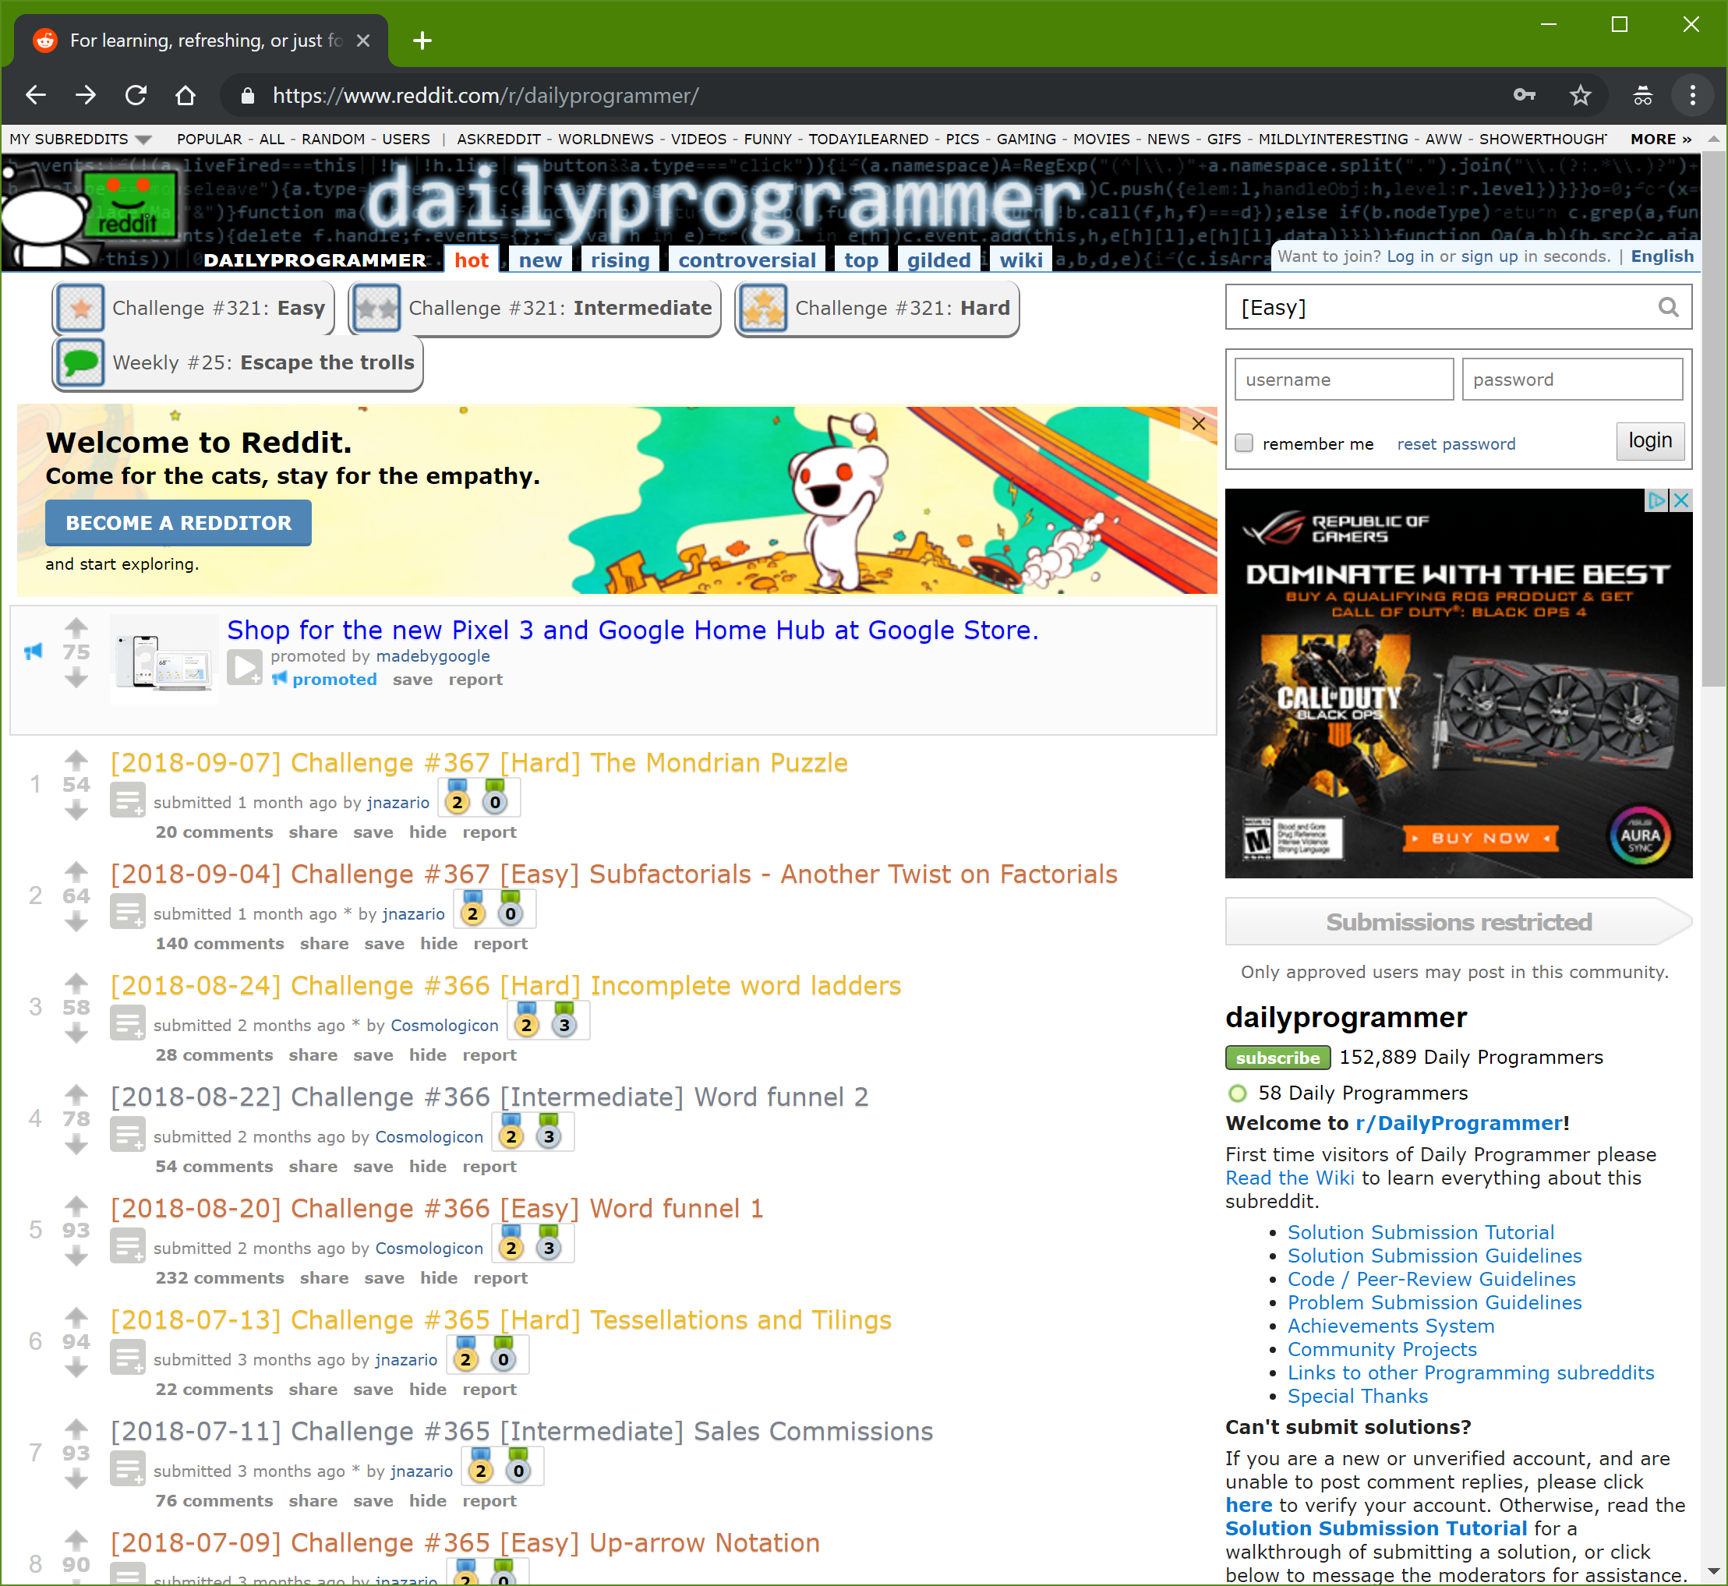
What is it?
https://www.reddit.com/r/dailyprogrammer/
Board admins post a “Hard”, “Intermediate”, and “Easy” programming problem every day
Post describes the problem and gives some example test data (inputs and expected outputs)
Users post replies with their source code and a description, usually done in a variety of languages
You can try to solve the problem and compare your results to the posts.
You also get to see the solutions in many different programming languages.
Comments offer suggestions for improvements, better ways ,etc.
Warning: Reddit at times can be a bit of a “wild wild west” environment. Not all comments are constructive and some users can use foul language.

